Slide 1
FP in OOP
(Functional Programming in Object-Oriented Programming)
Kostas Gkoutis
IBM CIC Netherlands
2023

Slide 2
Expectations Management
Yes:
Basic concepts
Advantages
Practice
Passage to OOP
Not:
too much theory
Everything there is to know about FP

Slide 3
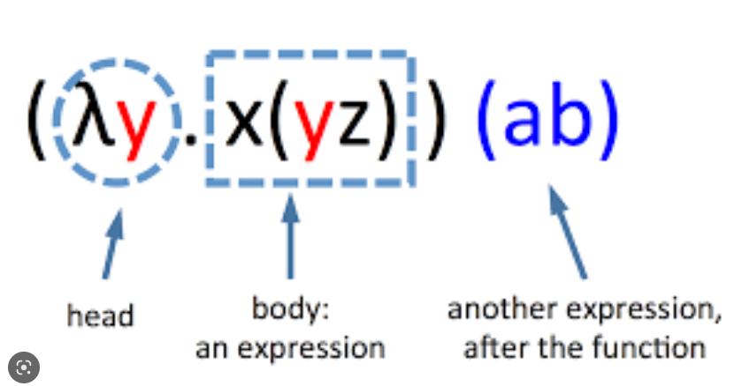
What is functional programming (FP)?
Most simply put, it is a family of concepts that leads to treat computation as the evaluation of mathematical functions. It leads to an alternative way of creating programs by passing application state exclusively through functions that combine and transform it. This combination of functions is called function composition.
The historical roots of functional programming are in Lambda Calculus, a formal system that was developed in the 1930s by Alonzo Church and others. It is a formal system that is based on the concept of functions as mathematical objects.
x := 7 (value, cannot change!)
f := λx.x+1 (assignment, cannot change!)
y := f 2 (function application)
g := λx.x+y (free variable)
b := g x
Source: http://bach.ai/lambda-calculus-for-absolute-dummies/

Slide 4
What is functional programming (FP)?
FP languages adopted lambda calculus into their principles, but it doesn’t always help the issues with functional purity/referential transparency (more on that later).
Solutions:
don’t follow functional purity everywhere (ignore the “issue”!)
Adopt yet another theory, Category Theory. CT, is another (very abstract) branch of mathematics, that was brought into picture in order to help with abstracting computation and allow (more) referential transparency in effectful computations of FP languages
We are not going to talk at all about CT or LC. Why?

Slide 5
What is functional programming (FP)?
By now, you may have heard/come into conclusion that FP is only for the mathematical-inclined. That’s not really true. Many things in programming have a mathematical underpinning but we still use them unhindered in everyday life.
Number representation in programming languages.
Relation theory for SQL
Mathematical properties for equals/hashcode etc.
The 2 theories influenced the various FP languages a lot.
LC: syntax, function composition, partial application, currying, recursion, HOFs,
immutability, lazy evaluation etc.
CT: functional purity/referential transparency, abstracting computation, type systems etc.

Slide 6
What is functional programming (FP)?
Functional purity/Referential transparency: what do these terms mean?
Functional purity is a property of pure functions. Pure functions are those that for a given input they always produce the same output and doesn’t have observable side effects. Example:
f x = x + 1 this is pure in contrast to f x = print x not pure, side effects.
Referential transparency is a vague term that no two mathematicians/FP programmers agree on what it exactly means. It speaks about the idea of being able to substitute subexpressions of an expression. So, a function is RT when evaluating a subexpression and “pasting” the result directly where it’s consumed doesn’t bring any change to the function.
f x = let z = 10, which is the same as f x = x + 10
y = x + z
in y
In practice, referential transparency implies heavily functional purity and vice versa. We would say that a function is pure/referentially transparent if
for a given input it produces the same output always and
it doesn’t communicate with the outside world/it has no side effects
  which also means, it is trivially unit-testable!!

Slide 7
What is functional programming (FP)?
(Popular forerunners):
Lisp, 1950s. Someone once said that every future language reinvents Lisp.
ML, 1970s. Static type system, ADTs.
Miranda, 1980s. Promoted (non-strict) lazy evaluation
Haskell, 1980s. A pure (and lazy) FP language, which means that it tries to eliminate side effects as much as possible. This is a very powerful concept, but it is also more difficult to implement/use/learn. Most FP languages do push for function purity, but every language follows this at all costs.
Scheme, 1970s. Popular dialect of Lisp.
Ocaml, 1996. Came from Caml (which came from ML) and adds OOP features.
Erlang, 1986. Built from Ericsson to improve telephone communication, admired for its multiprocessing capabilities that guarantee process isolation, message passing, asynchronicity and in general a good concurrency model. Still used today by software like e.g. message queues.
Scala, 2004. Its goal was to design a language that supported FP and OOP styles equally good. Rejuvenated the interest to FP techniques to other OOP languages.
Modern choices: Scala, F#, Clojure, PureScript, Elm, Elixir, Racket, Idris, Gleam, etc...
"Very functional" choices: Rust, Kotlin, (maybe) TypeScript, (maybe) Swift.

Slide 8
What is functional programming (FP)?
But the last 10 years or so, almost all languages incorporated FP features and keep doing it. You can write code in FP style in your language today (except if you program in some dinosaur like Fortran.. ☺ ).
Who hasn’t use something like map or filter in an array in his/her language?
Who hasn’t passed a callback to function? Who hasn’t written a lambda expression?
But functional programming is really different:
Say goodbye to: variables – we have values!
assignments – we have bindings!
loops – we have recursion!
if statements – ..we don’t have it, but we do have if-else expressions (not if-else statements)
switch statements - we have switch expressions – with pattern matching!
classes/enums/interfaces/inheritance – we have Algebraic Data Types!
side-effects – we don’t really use them….
global state – we have scopes and local state!
access modifiers (public, private, etc.) – we have closures and modules!
Then why should I care??

Slide 9
What is functional programming (FP)?
But why should I care??
Declarative (what) vs imperative (how) style. Most often than not, it’s more readable.
Simplicity: Without state and side effects, your functions tend to be smaller, doing “just what they are supposed to do.”
Consistency: Immutability of data makes them reliable and consistent. No more worries about program state changes without you knowing.
(Mathematical) Correctness: Simpler code with consistent data structures will automatically lead to “more correct” code with a smaller bug surface. The “purer” your code, the easier it will be to reason with, leading to simpler debugging and testing.
Safer Concurrency: Concurrency is a hard problem in all languages. Functional concepts allow you to eliminate many headaches and gain safer parallel-processing (almost) for free.
Modularity: Small and independent functions lead to simpler reusability and modularity. Combined with functional composition and partial application, you have powerful tools to build more complex tasks out of these smaller parts easily.
Reactivity: Reactive frameworks like Rx.Java and the various Actor frameworks refer to the reactive paradigm that adopts a lot of FP concepts.
Dumb data: Separation of data and behavior is another plus, in contrast to the mantra of OOP style.
Popularity: Everyone is doing it, even if you don’t like it, you better get at least familiar with it!

Slide 10
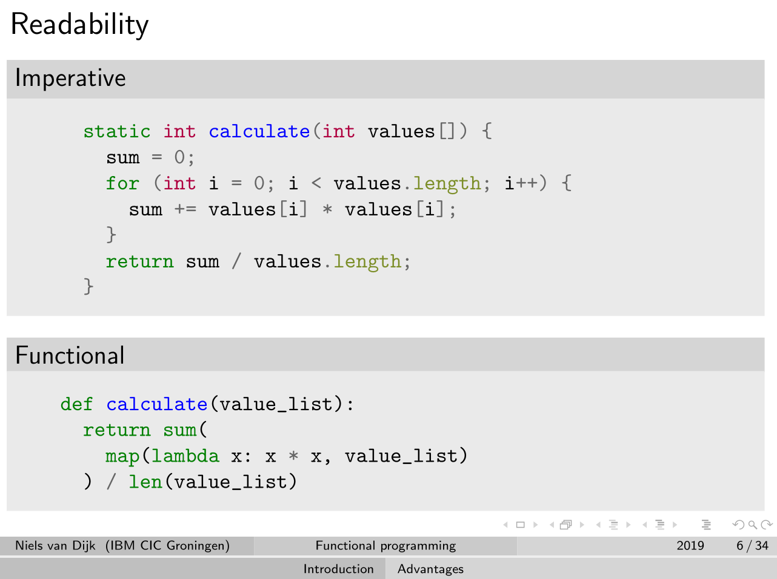
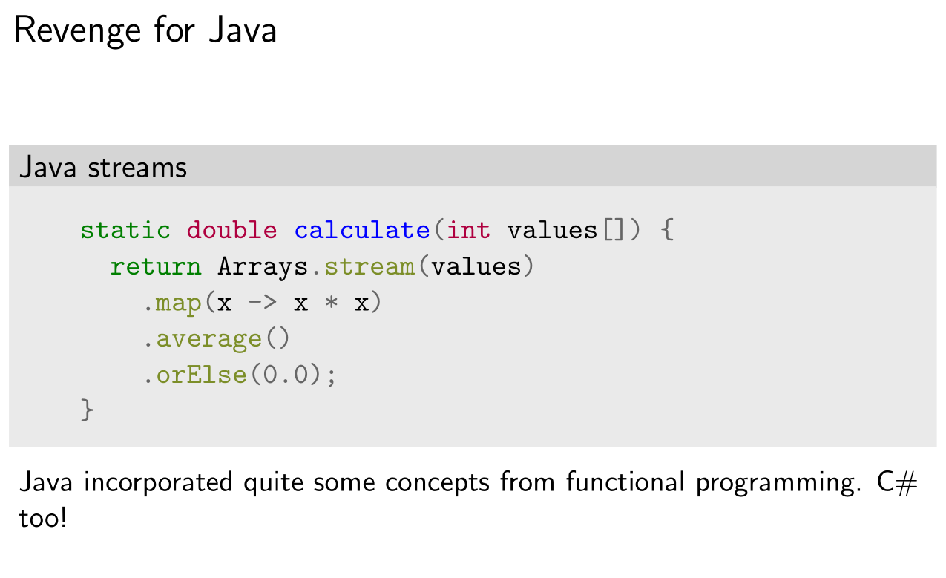
A glimpse at FP
Above: imperative style
Below: functional style

Slide 11
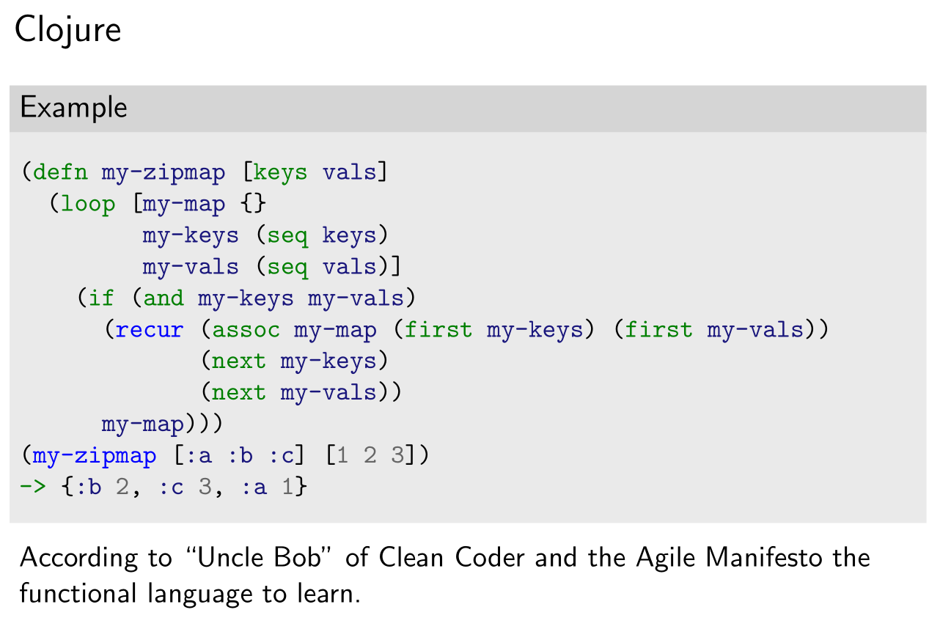
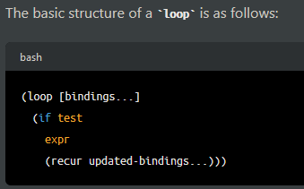
A glimpse at FP
Clojure belongs to the
LISP family of
programming languages

Slide 12
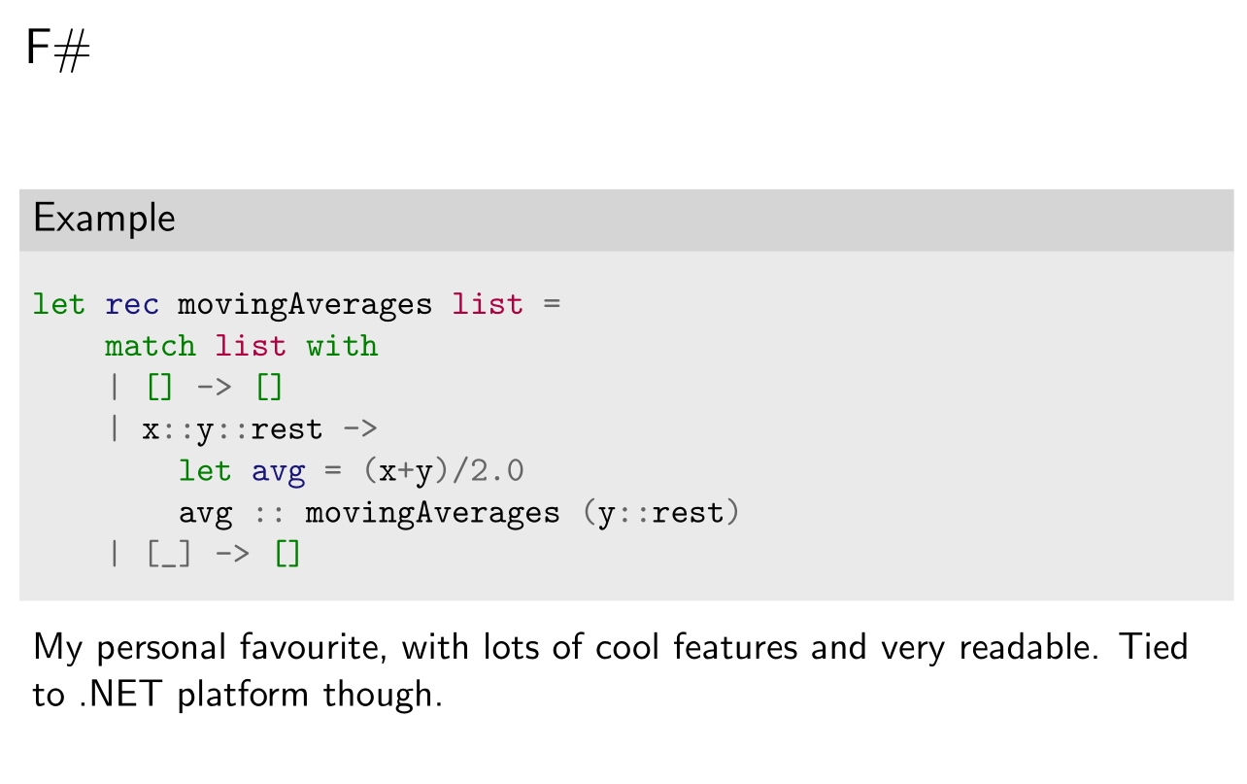
A glimpse at FP

Slide 13
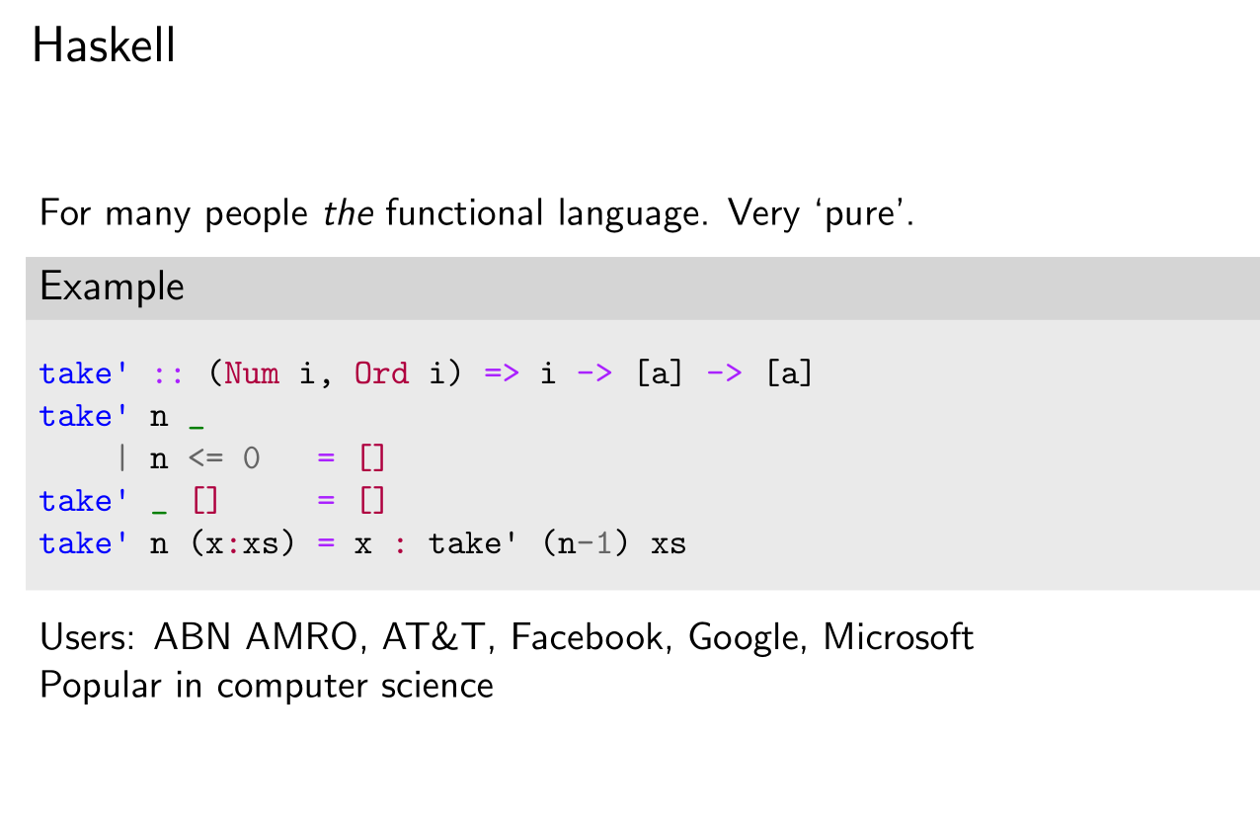
A glimpse at FP

Slide 14
FP in OOP
Q: I understand the benefits but not (all) the syntax. Should I learn an FP language then?
A: For your own good yes, you should. A good programmer is always polyglot.
But not today. This is a journey you must travel alone, on your own terms and pace.
It would take too much time to do it together, and chances are you wouldn’t really use this language
directly in your daily line of work.
Today we are going to invest our time in something different.
We are going to see how to apply FP concepts into OOP language like Java.
The course is named "Functional Programming in OOP" because we are trying to show that FP concepts can be used in OOP languages, and that they don’t have to come into conflict with OOP concepts. We are not trying to showcase how the two thought systems can coexist symbiotically.
Why Java?
Reference language, understood by most (supposedly)
It is one of the most averse to non-OOP concepts
Why not imperative languages?
Because it’s probably easier there to code in FP style. Again, probably. There is still overlap with our material here.

Slide 15
FP in OOP
We are going to speak about 2 categories of code (distinction is mine)
 | “Functional-must” code | “Functional-friendly” code
FP languages | Absolutely necessary | Unnecessary or at least optional
OOP languages | Necessary when writing in FP style | Helps a lot when writing in FP style
Examples | Function composition, pattern matching etc. | Builders, Factories, type composition, anti-primitive obsession etc.

Slide 16
FP in OOP
Reference material:
If you need to learn more about FP for OOP languages, the following series of Manning books can help:
Functional Programming in Java
Functional Programming in C#
Functional Programming in Scala
Functional Programming in Kotlin
Functional Programming in Javascript
..etc, whatever suits your needs, plus one more (upcoming) book for Java, that I took inspiration from for this course:
A Functional Approach to Java
If you want to solidify your knowledge about OOP, I (highly) recommend the following book (it will help you even if you are not a Java developer per se):
Effective Java 3rd edition
and if you want to go deeper to learning FP languages, the following books are recommended:
Learn You a Haskell for Great Good! (Haskell)
Haskell Programming from first principles (Haskell)
Programming in Scala 3rd edition (Scala)
Get Programming with F#: A guide for .NET developers (F#)

Slide 17
FP in OOP
Order of chapters:
1. Types Composition (exercise)
2. Function Composition
3. Dependency Injection / Functional Factories
4. Dependency Injection / Partial Application
5. Handling void and no input
6. Loan pattern
7. Side effects
-----------
8. Missing Abstractions (exercise)
9. Primitive Obsession
10. Building Patterns
-----------
11. Extending Types (exercise)
12. Streams
13. Immutability (exercise)
14. Pattern Matching
15. Lazy Evaluation
-----------
16. Discriminated Unions
17. Exception Handling
18. Lenses and Prisms

